Slide 1
Understanding CSS Essentials: Content Flow, Positioning, and Styling
Vyacheslav Koldovskyy Last update: 12/01/2015

Slide 2
Agenda
Presentation versus content
CSS basics
The link between HTML and CSS
CSS selector and declaration
Fonts and font families
Web-safe fonts and @font-face rule
Inline flow and block flow
Float and absolute positioning
Overflow

Slide 3
Presentation vs. Content
Content is the words and images in an HTML document.
Presentation is related to styles and how words and images "look" in an HTML document.
Content is managed as HTML and style as CSS.
The separation of HTML and CSS generally means keeping CSS styles in a file separate from the HTML file.
Notes:
Tip: Add your own speaker notes here.

Slide 4
CSS
CSS = Cascading Style Sheets
CSS is a sequence of rules.
CSS3 is the latest version, corresponds to HTML5
CSS3 is that it’s backward compatible with previous versions of CSS
Notes:
Tip: Add your own speaker notes here.

Slide 5

How to add CSS to HTML?
1. Inline CSS:
<h1 style="color:blue;margin-left:40px;">Some header</h1>
2. Internal Style Sheet:
<head>
<style> h1 { color: blue; margin-left: 40px; } </style>
</head>
3. External file:
<head>
<link rel="stylesheet" href="default.css">
</head>

Slide 6
The Link Between HTML and CSS
The <link> element in an HTML file links the HTML file to a CSS file.
You can reference more than one CSS file in an HTML page.
Markup example:
<link href = "filename.css" rel = "stylesheet" type = "text/css">
For simple projects, can use the <style> tag to include styles within an HTML document
Notes:
Tip: Add your own speaker notes here.

Slide 7
CSS Selector and Declaration
The selector is usually the HTML element you want to style. The declaration is the style for a specific selector. A declaration has a property, which is a style attribute, and a value.
Selector
Declaration
p
{color: brown;}
Property
Value
Notes:
Tip: Add your own speaker notes here.

Slide 8
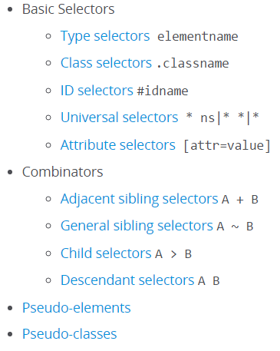
CSS selectors
https://developer.mozilla.org/en-US/docs/Web/CSS/Reference#Selectors

Slide 9
CSS Selectors - General
Selector | Example | Example description
.class | .intro | Selects all elements with class="intro"
#id | #firstname | Selects the element with id="firstname"
* | * | Selects all elements
element | p | Selects all <p> elements
element,element | div, p | Selects all <div> elements and all <p> elements
element element | div p | Selects all <p> elements inside <div> elements
element>element | div > p | Selects all <p> elements where the parent is a <div> element
element+element | div + p | Selects all <p> elements that are placed immediately after <div> elements
element1~element2 | p ~ ul | Selects every <ul> element that are preceded by a <p> element

Slide 10
CSS Selectors - Attributes
Selector | Example | Example description
[attribute] | [target] | Selects all elements with a target attribute
[attribute=value] | [target=_blank] | Selects all elements with target="_blank"
[attribute~=value] | [title~=flower] | Selects all elements with a title attribute containing the word "flower"
[attribute|=value] | [lang|=en] | Selects all elements with a lang attribute value starting with "en"
[attribute^=value] | a[href^="https"] | Selects every <a> element whose href attribute value begins with "https"
[attribute$=value] | a[href$=".pdf"] | Selects every <a> element whose href attribute value ends with ".pdf"
[attribute*=value] | a[href*="w3schools"] | Selects every <a> element whose href attribute value contains the substring "w3schools"

Slide 11
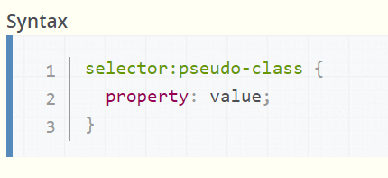
CSS Pseudo-classes
A CSS pseudo-class is a keyword added to selectors that specifies a special state of the element to be selected. For example :hover will apply a style when the user hovers over the element specified by the selector.
Pseudo-classes, together with pseudo-elements, let you apply a style to an element not only in relation to the content of the document tree, but also in relation to external factors like the history of the navigator (:visited, for example), the status of its content (like :checked on some form elements), or the position of the mouse (like :hover which lets you know if the mouse is over an element or not). To see a complete list of selectors, visit CSS3 Selectors working spec.

Slide 12
CSS pseudo-elements
Just like pseudo-classes, pseudo-elements are added to selectors but instead of describing a special state, they allow you to style certain parts of a document.
For example, the ::first-line pseudo-element targets only the first line of an element specified by the selector.
All pseudo-elements
::after
::before
::first-letter
::first-line
::selection
::backdrop
selector::pseudo-element {
property: value;
}

Slide 13
CSS Selectors – pseudo-classes and pseudo-elements
Selector | Example | Example description
:active | a:active | Selects the active link
::after | p::after | Insert something after the content of each <p> element
::before | p::before | Insert something before the content of each <p> element
:checked | input:checked | Selects every checked <input> element
:disabled | input:disabled | Selects every disabled <input> element
:empty | p:empty | Selects every <p> element that has no children (including text nodes)
:enabled | input:enabled | Selects every enabled <input> element
:first-child | p:first-child | Selects every <p> element that is the first child of its parent
::first-letter | p::first-letter | Selects the first letter of every <p> element
::first-line | p::first-line | Selects the first line of every <p> element
:first-of-type | p:first-of-type | Selects every <p> element that is the first <p> element of its parent
:focus | input:focus | Selects the input element which has focus
:hover | a:hover | Selects links on mouse over
Details: http://www.w3.org/TR/css3-selectors/

Slide 14
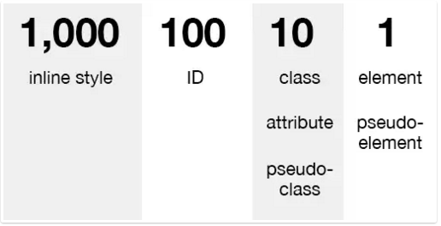
CSS Specificity
Specificity is the means by which a browser decides which CSS property values are the most relevant to an element and therefore will be applied. Specificity is only based on the matching rules which are composed of css selectors of different sorts.
The specificity is a weight that is applied to a given CSS declaration based on the count of each selector type. In the case of specificity equality, the latest declaration found in the CSS is applied to the element.
Details: https://css-tricks.com/specifics-on-css-specificity/

Slide 15
The !important exception
When an !important rule is used on a style declaration, this declaration overrides any other declaration made in the CSS, wherever it is in the declaration list.
Although, !important has nothing to do with specificity.
Using !important is bad practice and should be avoided because it makes debugging more difficult by breaking the natural cascading in your stylesheets.

Slide 16
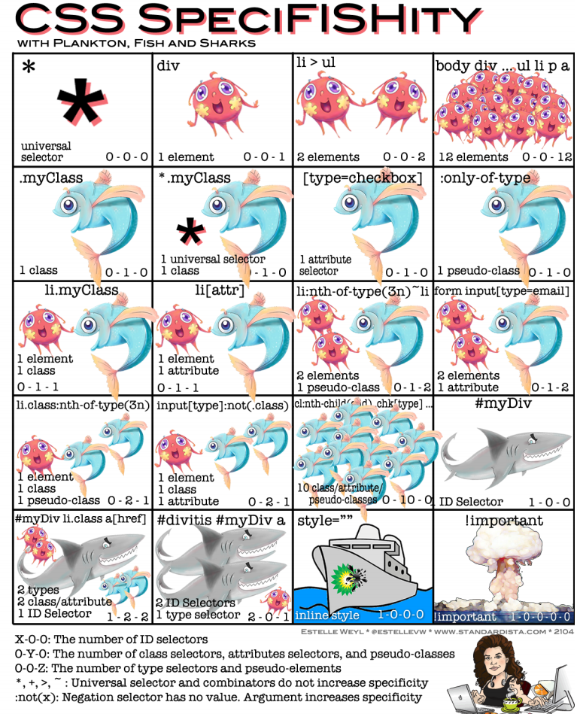

Slide 17
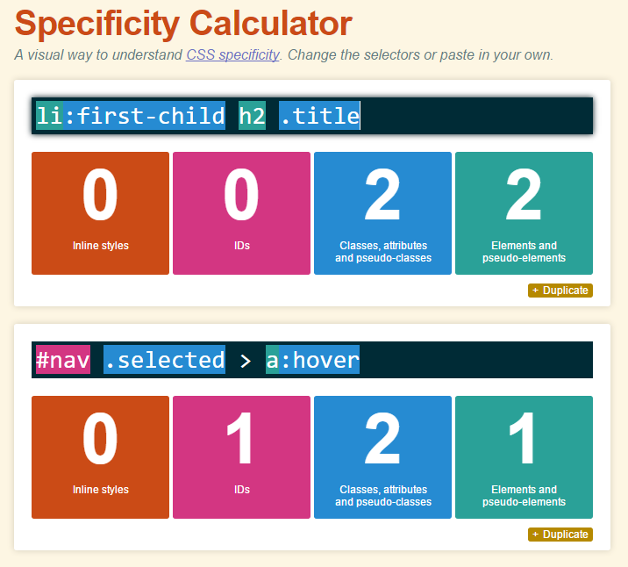
CSS Specificity Calculator
http://specificity.keegan.st/

Slide 18
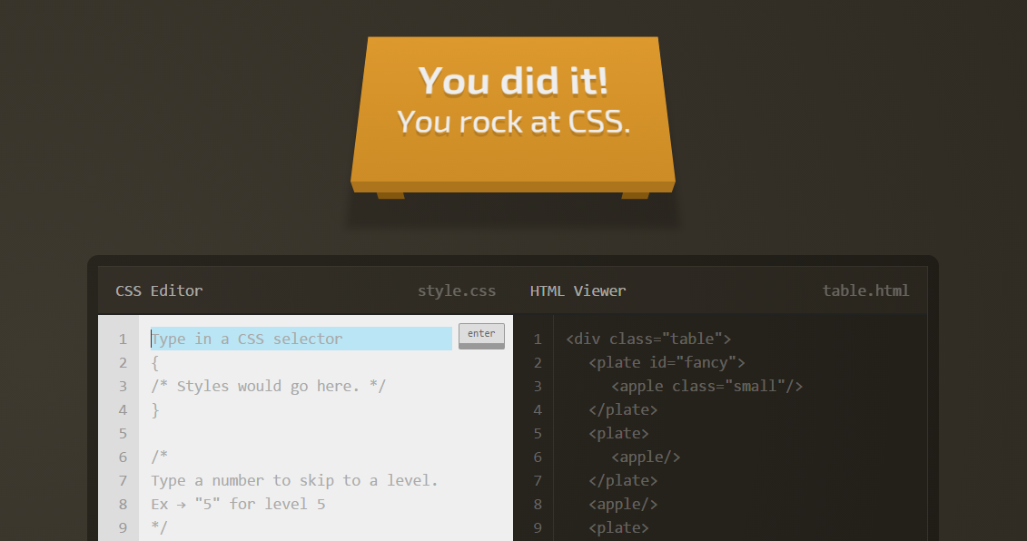
Practice Task: Pass CSS Game
http://flukeout.github.io/

Slide 19
Font Basics
A font is a set of characters of a particular size and style.
Examples:
Times New Roman
Eras Bold ITC
Myriad Web Pro
Monospace is often used for technical material such as formulas, numbers, codes, and so on.
Notes:
Tip: Add your own speaker notes here.

Slide 20
Serif and Sans Serif Fonts
Serif
Sans serif
d p t
d p t
Notes:
Tip: Add your own speaker notes here.

Slide 21
Font Families
The primary way to specify fonts in a CSS file is to use the font-family property.
The property can declare a specific font, like Garamond or Arial, or a family that includes many different fonts, such as “serif.”
Examples:
font-family: Arial
font-family: serif
Notes:
Tip: Add your own speaker notes here.

Slide 22
Web-safe Fonts
Fonts most likely installed on a Web page visitor’s system
List of Web-safe fonts is relatively short and doesn’t offer much variety
Notes:
Tip: Add your own speaker notes here.

Slide 23
@font-face Rule
CSS3 rule that enables developers to use any font they choose
Create a font-face rule by assigning a name to the font
Font must be located on your Web server, or include a URL to font location
Example:
@font-face
{
font-family: TrustyHomePage;
src: url('Euphemia.ttf'),
}
Notes:
Tip: Add your own speaker notes here.

Slide 24
Inline Flow and Block Flow
Inline flow fills only as much width as required
Block flow fills as much width as is available
Notes:
Tip: Add your own speaker notes here.

Slide 25
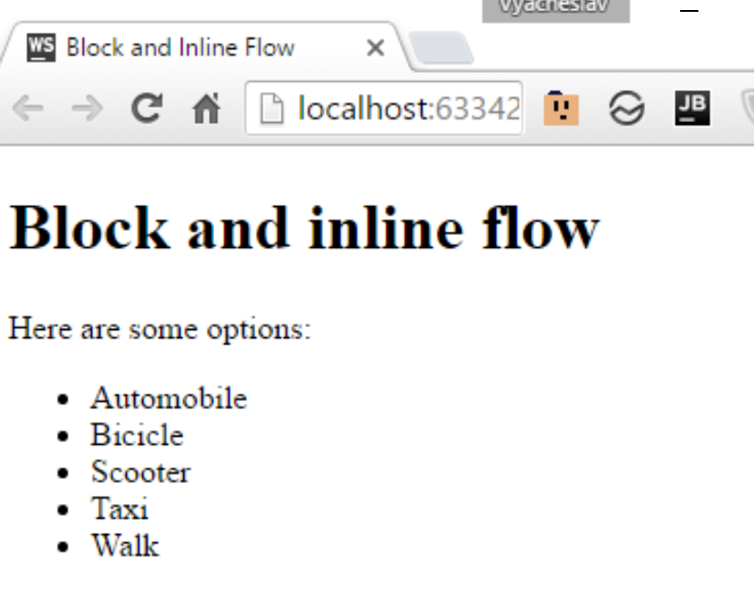
Block Flow Example
<!doctype html> <html> <head> <title>Block and Inline Flow</title> </head> <body> <h1>Block and inline flow</h1> <p>Here are som options:</p> <ul class="toolbar"> <li>Automobile</li> <li>Bicicle</li> <li>Scooter</li> <li>Taxi</li> <li>Walk</li> </ul> </body> </html>
Notes:
Tip: Add your own speaker notes here.

Slide 26
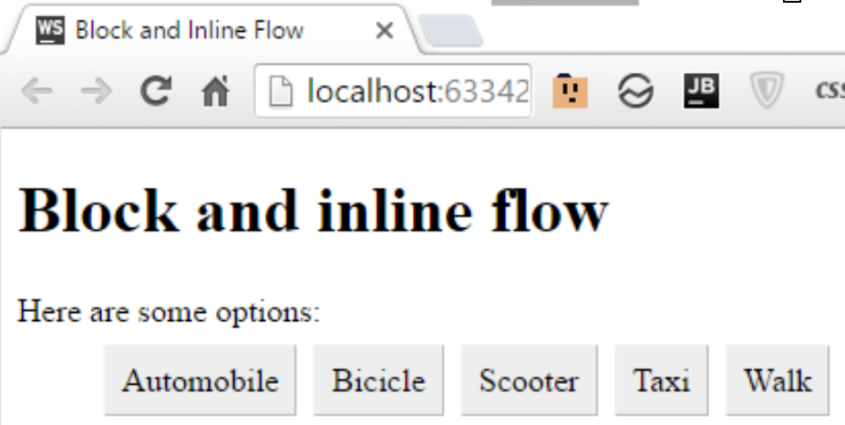
Inline Flow Example
<!doctype html> <html> <head> <title>Block and Inline Flow</title> <style> .toolbar li { display: inline; background-color: #EEE; border: 1px solid; border-color: #F3F3F3 #BBB #BBB #F3F3F3; margin: 2px; padding: .5em; } </style> </head> <body> <h1>Block and inline flow</h1> <p>Here are some options:</p> <ul class="toolbar"> <li>Automobile</li> <li>Bicicle</li> <li>Scooter</li> <li>Taxi</li> <li>Walk</li> </ul> </body> </html>
http://plnkr.co/edit/2ZQXJkbNMiqeV18n6pSV?p=preview

Slide 27
CSS Positioning
The position Property
The position property specifies the type of positioning method used for an element.
There are four different position values:
static
relative
fixed
absolute
Elements are then positioned using the top, bottom, left, and right properties. However, these properties will not work unless the position property is set first. They also work differently depending on the position value.
Z-Index: allows to place one element above another.
Details and samples: http://www.w3schools.com/css/css_positioning.asp

Slide 28
Float Positioning
Float positioning
Is useful when a layout is in columns, at least in part
To float an element is to have it move as far as possible either to the right or left
Text “wraps” around the element
The float property specifies whether or not an element should float.
The clear property is used to control the behavior of floating elements.
Notes:
Tip: Add your own speaker notes here.

Slide 29
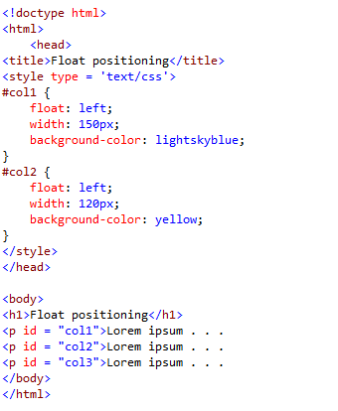
Float Positing Example
Notes:
Tip: Add your own speaker notes here.

Slide 30
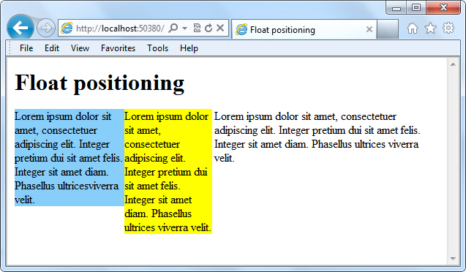
Float Positing Example
Notes:
Tip: Add your own speaker notes here.

Slide 31
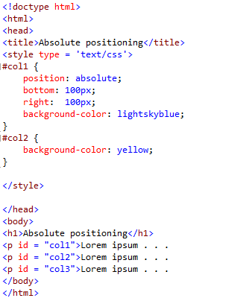
Absolute Positioning Example
Notes:
Tip: Add your own speaker notes here.

Slide 32
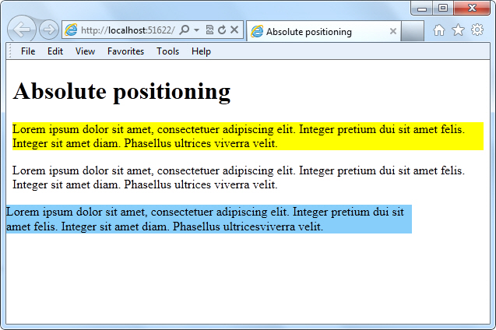
Absolute Positing Example
Notes:
Tip: Add your own speaker notes here.

Slide 33
Bounding Box
A bounding box is a rectangular border around content -- text, an image, or a shape -- that enables you to move, rotate, or scale the content of the box.
Bounding box can be visible or invisible.
Notes:
Tip: Add your own speaker notes here.

Slide 34
Overflow
When an element overflows its bounding box, and its overflow is set to scroll, all the content of the element stays within the box; none of the overflow appears outside the box. This is referred to as scrolling overflow.
Visible overflow writes over the content that follows it.
Hidden overflow makes overflow invisible.
Notes:
Tip: Add your own speaker notes here.

Slide 35
Overflow
overflow property
Values:
Scroll
Visible
Hidden
Notes:
Tip: Add your own speaker notes here.

Slide 36
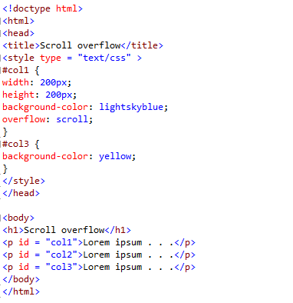
Scrolling Overflow Example
Notes:
Tip: Add your own speaker notes here.

Slide 37
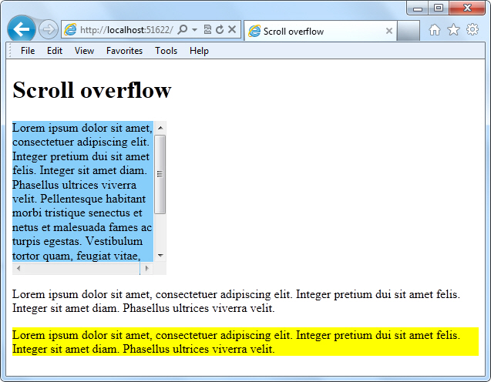
Scrolling Overflow Example
Notes:
Tip: Add your own speaker notes here.

Slide 38
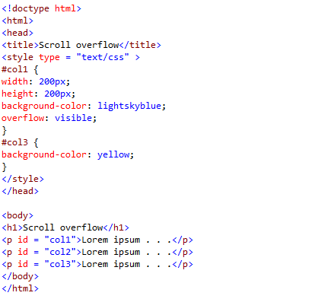
Visible Overflow Example
Notes:
Tip: Add your own speaker notes here.

Slide 39
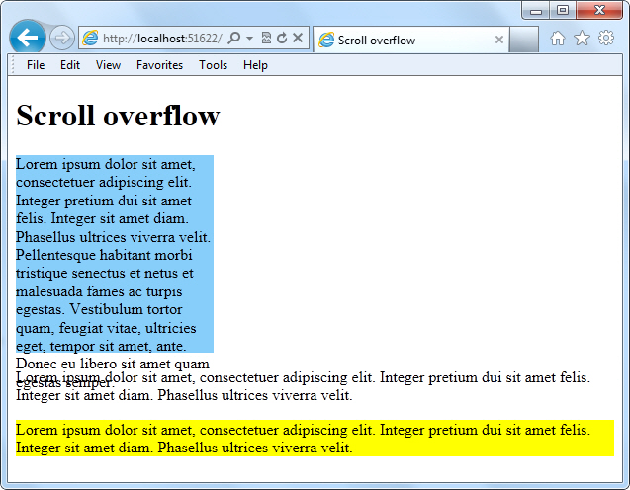
Visible Overflow Example
Visible overflow
Notes:
Tip: Add your own speaker notes here.

Slide 40
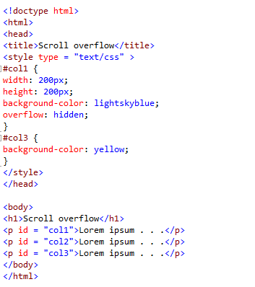
Hidden Overflow Example
Notes:
Tip: Add your own speaker notes here.

Slide 41

Hidden Overflow Example
Notes:
Tip: Add your own speaker notes here.

Slide 42
Practice Task

Slide 43
Contacts
Europe Headquarters
52 V. Velykoho Str.
Lviv 79053, Ukraine
Tel: +380-32-240-9090 Fax: +380-32-240-9080
E-mail: info@softserveinc.com
Website: www.softserveinc.com
US Headquarters
12800 University Drive, Suite 250 Fort Myers, FL 33907, USA
Tel: 239-690-3111 Fax: 239-690-3116
Thank You!
Copyright © 2010 SoftServe, Inc.

